Slide 1
Ways to make the school better
By Natalie Avila

Slide 2
Spirit Day
Kids dress up in the school colors and they represent it, which is because because makes other believe they like the school and support it.

Slide 3
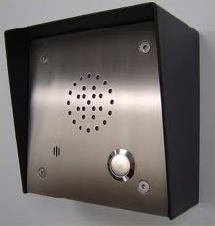
Announcements
We should have announcements through an intercom like that we all listen to what’s going and and can hear it better than hearing a teacher say it.

Slide 4
Pep rally
If we have pep rally it will make the school much more exciting and fun, more students will want to come see what fun activities they will do at the rally

Slide 5
Sports
We should have our sports like that our school has something to support, and we can go and watch our teams play at other schools

Slide 6
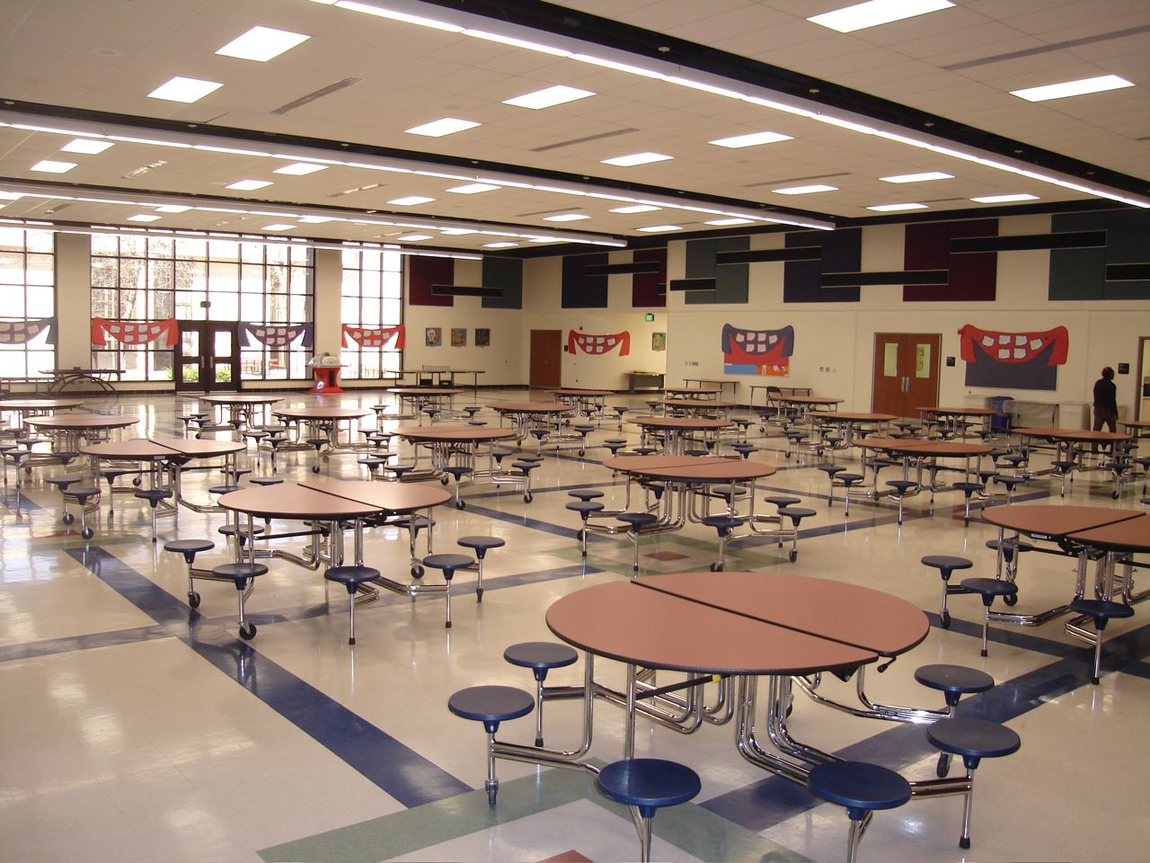
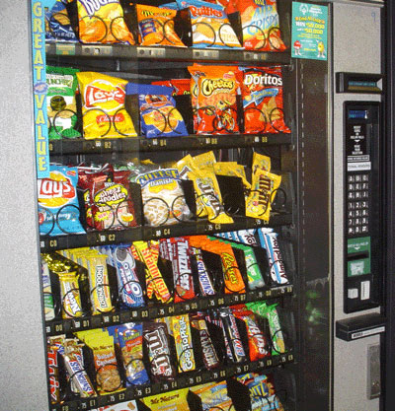
Cafeteria
We need a cafeteria or at least a vending machine because most of time students don’t bring or forget there lunch, also because students take longer when they go out on there brake and come in late for there next class.

Slide 7
A French Class
We should have a French class because we have a Spanish class and learning another language gives us bigger opportunities in the world

Slide 8
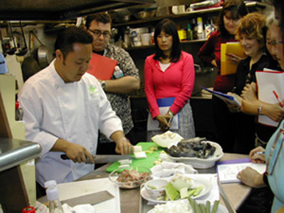
Cooking Class
Fun for everyone, better chance to communicate and to make different types of foods and at the end it.

Slide 9
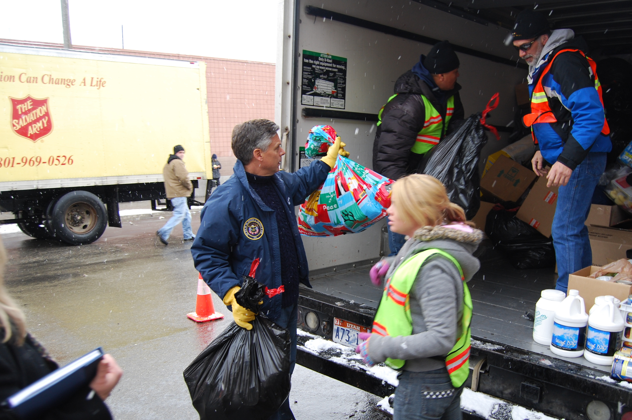
Donate Clothes
We can donate clothes that we don’t use and five it to those who do need it.

Slide 10
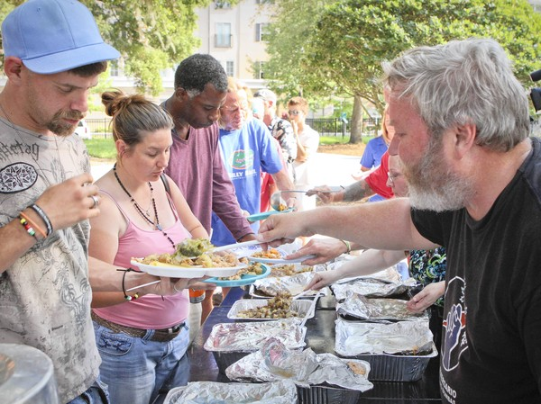
Serve food to people in need
Sep up tables and food and have people who are hungry and can’t afford much come and sit down let us serve them.

