Slide 1
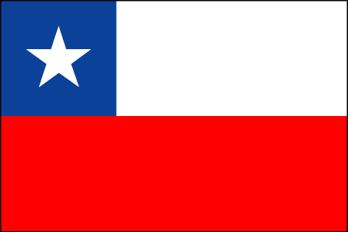
Chile
By: Natalie Avila

Slide 2
History
Chile was originally under the control of the Incas in the north and the nomadic Araucanos in the south. In 1541, a Spaniard, Pedro de Valdivia, founded Santiago. Chile won its independence from Spain in 1818 under Bernardo O'Higgins and an Argentinian, José de San Martin. O'Higgins, dictator until 1823, laid the foundations of the modern state with a two-party system and a centralized government.
The dictator from 1830 to 1837, Diego Portales, fought a war with Peru from 1836—1839 that expanded Chilean territory. Chile fought the War of the Pacific with Peru and Bolivia from 1879 to 1883, winning Antofagasta, Bolivia's only outlet to the sea, and extensive areas from Peru. Pedro Montt led a revolt that overthrew José Balmaceda in 1891 and established a parliamentary dictatorship lasting until a new constitution was adopted in 1925. Industrialization began before World War I and led to the formation of Marxist groups. Juan Antonio Ríos, president during World War II, was originally pro-Nazi but in 1944 led his country into the war on the side of the Allies.
In 1970, Salvador Allende became the first president in a non-Communist country freely elected on a Marxist program. Allende quickly established relations with Cuba and the People's Republic of China, introduced Marxist economic and social reforms, and nationalized many private companies, including U.S.-owned ones. In Sept. 1973, Allende was overthrown and killed in a military coup covertly sponsored by the CIA, ending a 46-year era of constitutional government in Chile.

Slide 3
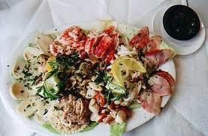
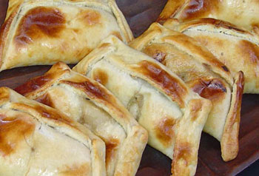
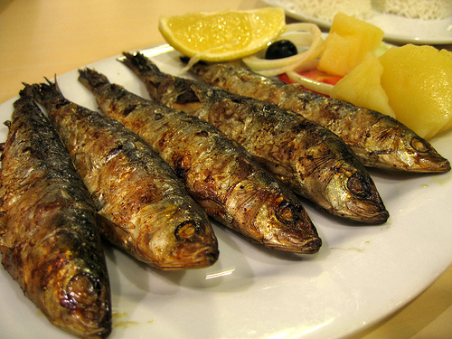
Food
Typical meals in Chile consist mainly of lots of meat, especially beef and chicken, rice and potatoes, fresh fruit and vegetables from the fields of Central Chile. Even though seafood could be the common daily meal in Chile with its 5.000 km long coast, it is not. But you will surely find a fresh seafood selection on every menu.
Arrollado de Chancho - Chunks of pork wrapped in pork fat smothered in red ají (chili).
Bistec a lo pobre - beefsteak, French fries, fried onions, topped with a couple of fried eggs. (Photo to the right)
Carbonada - meat soup with finely diced beef and all kinds of vegetables such as potatoes, onions, carrots, broccoli, green pepper and parsley.
Chancho en Piedra - a typical Chilean seasoning. Tomatoes, garlic, and onions grounded together in a stone.
Charquican - ground or diced meat cooked with garlic, onions, potatoes and pumpkin all mashed. It is a mushy dish but great.
Cazuela de Ave - chicken soup with pieces of meat, potatoes, green beans or peas, rice or noodles.
Cazuela de Vacuno - beef soup with pieces of meat, potatoes, corn on the cob, carrots, onions, green beans, garlic, chunks of pumpkin, rice or noodles.
Charquicán - Potato, pumpkin, mince, onion, carrot sometimes with peas and corn (both optional) all mashed together.
Costillar de Chancho - baked spare (pork) ribs.
Curanto en Hoyo - a typical dish from the south of Chile. Traditionally prepared by heating fish, seafood, potatoes, some meat, milcaos and types of bread over red hot rocks in a hole in the ground. The food is wrapped in big leaves and then covered with dirt so that it slowly cooks over a number of hours. (Similar to a hangi in New Zealand)
Curanto en Olla - same ingredients as the curanto en hoyo only that it is cooked in a pot instead of under the ground. Photo on the right.
Empanada de Pino - typical turnover filled with diced meat, onions, olive, raisins and a piece of hard-boiled egg, baked in earthen or Typical Chilean Desserts (and sweet things)
Alfajor - a flat round pastry (almos like two biscuits together) filled with manjar and covered in Chocolate

Slide 4
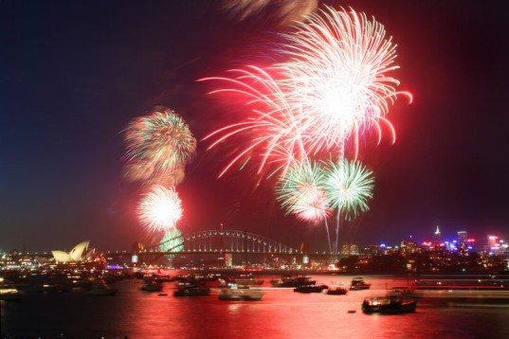
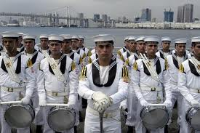
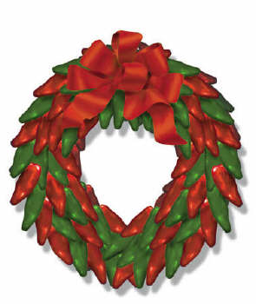
Holidays/Festivals
Through out the whole year Chilean have about 15 holidays in total that they celebrate and those are,
January 1: New Years Day
March or April: Easter & Holy week
May 1: Labor Day or Day of the Worker
May 21: Navy Day
June 29: Saint Peter & Saint Paul
July 16: Fiesta de la Virgin del Carmen
August 15: Assumption of Mary
September 18: Independence Day
October 12: Armed Forces Day
October 31: Columbus Day
November 1: All Saints Day
December 8: Immaculate Conception
Mid Dec: Election Day
December 25: Christmas

Slide 5
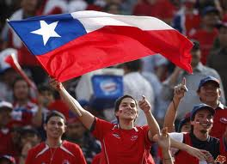
Sports
There are only few public sports in Chile, private sports are exclusive and expensive. But the national sport you will see everyone playing will be soccer. In Chile it would be really hard to find other sports. But if you like swimming, gymnastics or fitness center, skiing, and trekking and climbing you will be able to do in Chile. Chile has he wonderful mountain Andes mountain which is fun to explore and hike and do other fun activities.

Slide 6
Religion
The Chileans compromise themselves to Christian and to Protestants.
The estimation in the year of 1990-91 calculated almost half the population (52.1%) practiced Protestantism. These people mostly belonged to the poorer groups, while a small group of 2.3% led a life of extravagance. The Catholics in Chile hailed from the rich families or belonged to an elite class in the society. Almost 16% of the population call themselves Evangelical, a term which implies their institution to be non-Catholic churches, but they do have orthodox faiths like the protocols of Seventh-Day Adventists, Church of Jesus Christ of Latter-day Saints and Jehovah's Witnesses
Some of the Chilean population also practice Jewish religion
As long as there choice of religion doesn’t disrespect others they have the freedom to choose what they want to be.

Slide 7
Population and Development
Chile is definitely a developed society. There are many different factors that support this statement. Among these factors are things such as nutrition, health, education and many others. For example, only 1 percent of the children five years old and below are underweight. That is a very low percentile and it means that most of the young children in the country are well nourished. Ninety five percent of the entire Chilean population has improved drinking water sources. That is also very high. That means that only five percent of the population does not have access to a water source that have somehow been improved from its natural state. In Chile, one hundred percent of the routine EPI vaccines are financed by the government. EPI stands for expanded programmed on immunization. The EPI vaccines are the vaccines for common diseases that the world sees. These vaccines are very successful in preventing the harmful diseases. The literacy rates for the citizens of Chile are immensely high. The literacy rate for males from the ages of fifteen to twenty four years is ninety nine percent. The same literacy rate of ninety nine applies for women for the exact same age group, fifteen to twenty four year olds. In Chile, there are eighty four phones per one hundred people. That is not tremendously high but it is by no means low. It is a pretty high number for a country to have. A large amount of the population in Chile is urbanized, around eighty eight percent. That means that most of the population lives in cities and that is a clear sign that a country is developed. It’s a sign because urbanization creates more economic activity which leads to a growth in the country‘s economy. That is fairly high considering the fact that there are some very developed countries whose percentage is lower than that. For example, the United States which is clearly a developed country, has an urbanization percentage of eighty percent. These statistics obviously support the statement that Chile is a developed country.

Slide 8
Environment
Chile has a wide variety of natural resources. These include: copper, iron ore, coal, nitrates, metals such as gold, timber and hydropower. Most of their resources but obviously not all, come from caves. Chile is able to make a great amount of money each year from the exportation of valuable minerals. For example, Chile made over 1.7 billion dollars from copper alone in 1997. Another very important form of money is the production and exportation of fruits and vegetables. Most of Chile has an amazing crop climate all year round. This means that many crops can be planted and sold throughout the entire year. Fresh fruit is Chile’s second best selling resource behind copper. In 2001, fresh fruit made Chile a total of 1.08 billion dollars. Another major source of money is the fishing industry. Since the 1960’s, the fishing industry has boomed dramatically. This is due to the demand of fish oil and the cultivation of fish such as salmon. Next, the environmental issues that exist Chile. The large increase of the population in the past thirty years has lead to a lot of pollution from industry and transportation. Chile’s main environmental issues are the pollution of the air, land, water and also deforestation. The air pollution comes from the large number of motor vehicles and factories all over the country. People are attempting to reduce air pollution by doing things like carpooling or riding the bus. Since Chile produces and exports a large number of resources, the water and land are damaged greatly. The rivers and lakes are polluted by the agricultural and domestic wastes. The wastes come from a wide variety of places such as factories. About 70% of waste water in Chile’s capital, Santiago, is treated. That is not a very good percentage. Chile is taking this seriously and many waste water processing plants are under construction. The land is being polluted by the pesticides and chemicals that are used to fertilize crops. Since crops are an important source of income, the land is under constant stress. Nothing is really being done at the moment to improve this issue. To take resources from the environment, a lot of energy is needed. Some mining companies are in the process of using hydroelectricity by building dams. Deforestation is another big issue. About 20% of the entire country is forest. Timber is a major victim of deforestation. All of the logging leads to soil erosion which ruins the land.

